Slide 1
CMSC 426 Principles of Computer Security
Security Features of Windows (and a bit of Linux)

Slide 2
Today’s Topics
Hardening
Windows hardening methods
Defender, automatic updates, security and group policy, etc.
Linux hardening methods
SELinux
On Thursday:
How to attack and get around these techniques

Slide 3
Hardening

Slide 4
What is Hardening?
Securing a system against attack, often using things that are built-in or already available on the system
Examples of hardening:
Reducing avenues of attack
Patching known vulnerabilities
Using encryption
Installing security measures
Firewall, anti-virus software
User-end (strong passwords, etc.)

Slide 5
Windows Features

Slide 6
Windows “Defender” Firewall
Sets the policy for inbound and outbound network traffic
By default, every network connection has the firewall enabled
Only default exception is machines on local network
Both outgoing and ingoing and ingoing have it enabled
Which one is more vulnerable to attack?
Thanks to the default state, the network connection is protected immediately, with no window of vulnerability

Slide 7
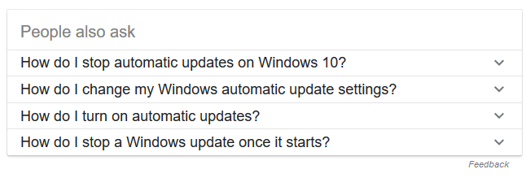
Windows Automated Updates
Automatically downloads and installs patches for the OS
Patches include fixes related to:
Bugs and issues (performance, etc.)
New features (updates to IE, etc.)
Security fixes and vulnerabilities

Slide 8
Microsoft Security Essentials (MSE)
Anti-virus software that provides protection against malware
Provides real-time protection
Monitors activity on the system
Scans new files as they are downloaded or created
If threat is detected, attempts to disable
Ethics: since it comes pre-installed with Windows, is this a violation of competition law?

Slide 9
Windows Defender
Replaces Microsoft Security Essentials in Windows 8 and up
Before that, Defender only protected against spyware
Switches itself off when third-party anti-virus is installed
Can still optionally perform periodic checks in this situation
Checks files from IE/Edge as they are downloaded
“Block at First Sight” uses machine learning to predict whether a file is malicious

Slide 10
Security Policy
Allows configuration of nearly all Windows security settings
Examples:
Password policy (min length, char types, etc.)
Guest accounts, lock out timer, etc.
LM, NTLM, and SAM settings
Access to machine via local
Shared desktop
Backup scheduling and restoring files

Slide 11
Group Policy
Allows network administrators to configure the security settings for an entire network of machines from one central location
Can also allow control of user accounts on a single machine
Settings are stored in “Group Policy Objects”
Policy examples:
Users may only run specific programs
Users may not have access to specific drives
Users may be prohibited from running as program as administrator

Slide 12
Auditing
Administrators can configure Windows to record different types of operating system activity
Activity examples:
Logon and logoff events
Changes made to user accounts
Changes made to security policies
Launching of applications
Users being granted or denied access to something
Windows starting up or shutting down

Slide 13
Security Log
These audited events are written to a security log
After a breach of security or a malware attack, the security log can be examined for information/evidence
Is actually admissible in court as evidence
Also possible to write false events to the log, but few accounts have the privilege to do that
Very important for accountability

Slide 14
User Account Control (UAC)
Helps prevent unauthorized changes to the operating system
The age-old question: “Do you want to allow the following program to make changes to this computer?”
Mitigates the effects of dumb users, as well as malware
If the account attempting to make changes is not an administrator, the changes are either not allowed, or a PIN or an admin’s password must be entered

Slide 15
Windows File Protection (WFP)
Present on Windows 2000 and XP
Ensures critical system files are not deleted or replaced
Windows keeps backups of these files in the location C:\WINDOWS\System32\DllCache
If a file is deleted or replaced, the OS restores it from that location
Uses authenticode digital signatures (i.e., file signing) to identify publisher and check for modifications to files

Slide 16
Windows Resource Protection (WRP)
Improved version of WFP in Windows Vista and beyond
Like WFP, protects essential system files
Also protects critical registry keys and folders
Admins no longer have full permissions to interact with system files
Full access is only granted to TrustedInstaller

Slide 17
BitLocker
Full disk encryption
Available in most professional and enterprise versions of Windows, starting with Vista
Older versions only encrypt the OS disk volume
Newer versions can encrypt the entire disk
Uses AES 128 or 256, and Cipher Block Chaining mode (CBC)
Unique CBC “chain” on each sector of the disk
Why do this?
Don’t have to re-encrypt the entire disk to save something

